Slide 1
Quality Assurance Committee
Dr Sally Priest, Flood Hazard Research Centre
on behalf of the QAC
6th April 2017

Slide 2
WP Self Assessment reports (Annex Q)
Thank you for all delivering the reports on time;
Reports show awareness of remaining activities/deliverables over the next year;
Majority of tasks to date have been on track - Milan already identified those activities which are a threat (i.e. accreditation) and some of those a bit out of the control of the project;
WP2.5 – delay in equipment purchasing, recognised and a strategy to tackle – aims to be completed by end Sept 2018
One comment from WP6 – to encourage more materials to be delivered from the HEI websites;
WP7 – realisation of the Staff and Student Mobility;

Slide 3
Partner Self-Assessment reports (Annex R)
Partners all report high awareness of their responsibilities and progress towards project outcomes;
No changes to the planned contributions were reported.

Slide 4
Deliverable reporting (Annex S)
Still behind on this – have not received Annex S from recent deliverables
Please can WP leaders check that when a deliverable is submitted that an Annex S is completed and submitted alongside it to the QAC team

Slide 5
Internal Quality Audit
In general the partners reported very favourably about the project, its organisation and implementation – with few significant issues or comments raised;
76 questionnaires from individual respondents were returned during July and August 2018 (in comparison to 66 in 2017);
The overall average response to all statements was 4.67/5 in close comparison to the 4.63 scored in 2017;
All averages were in the Excellent category – with a range of between 4.03 and 4.89.

Slide 6
Internal Quality Audit
Relative scoring of the statements - focussing in on those statements which scored less highly/written comments;
Responses suggested that partners knew less about other partners’ tasks – natural finding but maybe for consideration increasing information about all tasks;
“Project is well presented in the media” – although still averaged 4.49, this was lower than other statements;

Slide 7
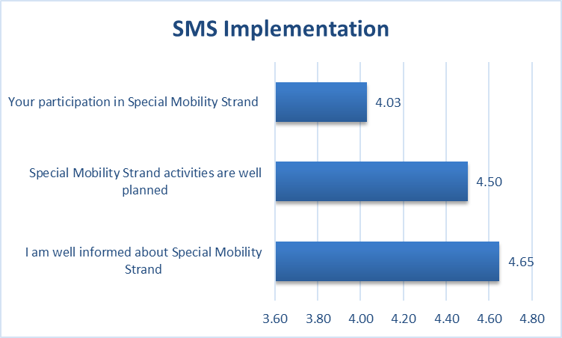
Internal Quality Audit
SMS Implementation – averages for the three statements all improved from 2017 – and now all in the excellent category;
But still lower than results from other categories;
Participation in SMS
Realise that this may be a bit delayed – strategy for improvement;
But also whether all read the question as applicable – lowest response rate

Slide 8
External Quality Audit

Slide 9
Some commendations
In general, there are some points of commendation and the report details the projects achievements to date;
Very detailed and comprehensive descriptions of the project, its aims and the process of realisation;
Praised the relevance of the project for addressing real and timely issues;
Highlights that they believe that the project is on track for meeting the objectives on time;
High level and comprehensive reporting and all realised activities are well documented and shared on the project website;
All the public documentation is transparent on the web site which is commended as being very functional and regularly updated;
…..now to discuss some of the recommendations – discuss whether these are within the scope of the project and how to address them;
Project – has add-on project values. WB partners creating International Relations Offices and associated documentation.

Slide 10
Some recommendations
Project dissemination and awareness
No evidence/activities outside the project scope to raise awareness level of relevant institutions and initiate project changes in local and national governments towards managing natural disaster risks;
Influencing practice – project should also realise or initiating a new strategy or procedure on risk management, by introducing project concepts/expertise to be built into national strategies and action plans;
A final dissemination event – include a more general audience (e.g. other WB universities/countries) to ensure a wider promotion of the project and its achievements. To improve regional co-operation/visibility;
Dissemination activities should also be used to motivate prospective students – e.g. open dates/promotional activities to raise awareness of the new programmes;
Some material is only available in Serbian – translating into English would increase the visibility of the project results.

Slide 11
Some recommendations
Consideration of project impact
To measure impact – suggests we need to compare before and after – but that data is lacking. Therefore recommendation is to undertake a questionnaire among relevant stakeholders to evaluate their level of preparedness – then a second one to evaluate the enhanced competencies through practical training and seminars
Link to WP3.1
Curricula content
Add to content in the curricula addressing how to realise resilient communication services protecting end-user applications in the case of disasters;
Recommend to put an accent on human initiated disasters, not just natural disasters;
Procedural/project management
Recommend reporting on the selection criteria/methodology of selection for all participants within the realised activities – in order to communicate whether the main target audience is clear and has been recruited;
Recommended a more systematic and documented way of reporting that the quality management strategy has been delivered; - link to Quality Control Plan – WP5.2;
Equipment – detail needed about what has been purchased and information about the distribution of handbooks

Slide 12
Some recommendations
Sustainability
More effort should be made to enable work positions for prospective students – increase motivation, and therefore, sustainability of the programmes. Suggest that this can be achieved through the initiation of a development strategy which would organise administrative/institutional support of managing the natural disaster risks;
Action plans needed to ensure financial sustainability and maintain that the university will continue to finance and organise the Masters curricula/trainings after the end of the project;

